Slide 1
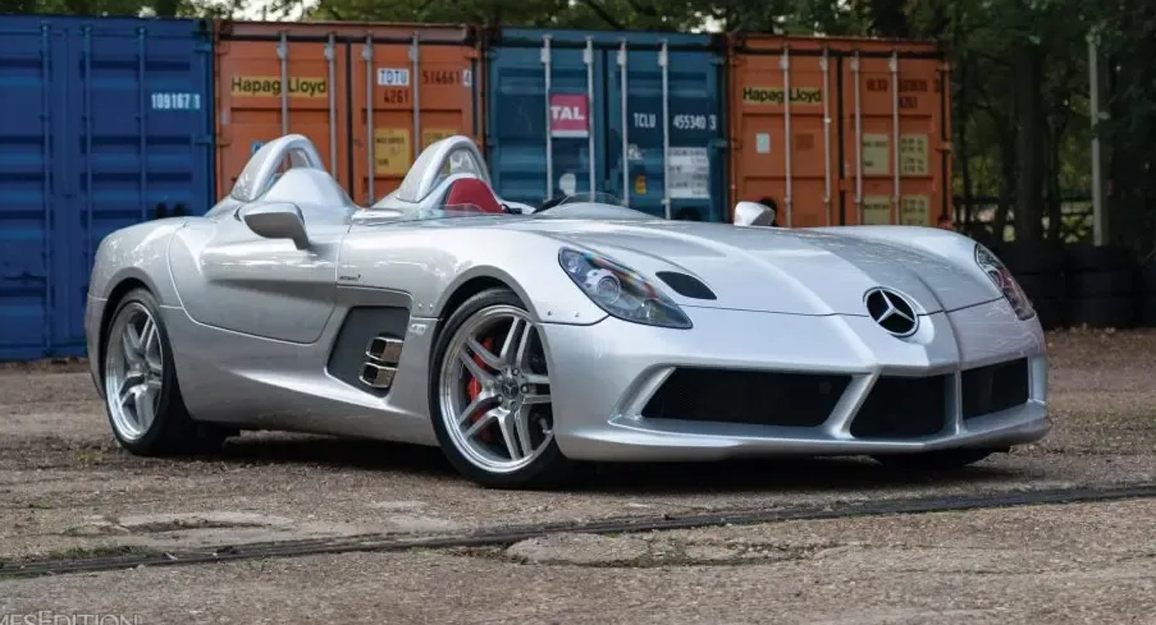
McLaren
Timeline Subtitle
Austin Elster
McLaren 12C
McLaren P1
.
McLaren M1B
McLaren GT
McLaren F1
Mercedes McLaren SLR
McLaren Senna
McLaren P1
1965
1992
2009
2017
1929
1969
2007
2013
2018

Slide 4
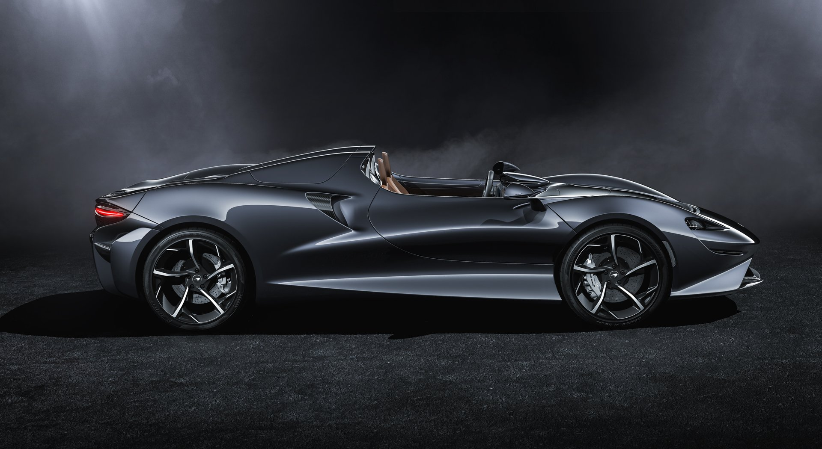
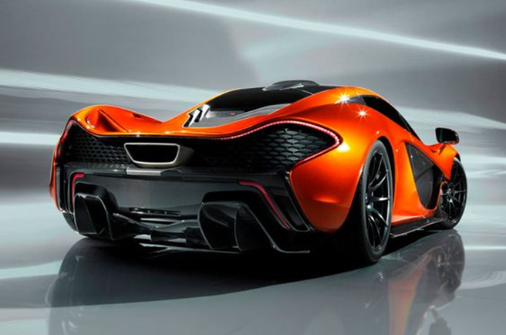
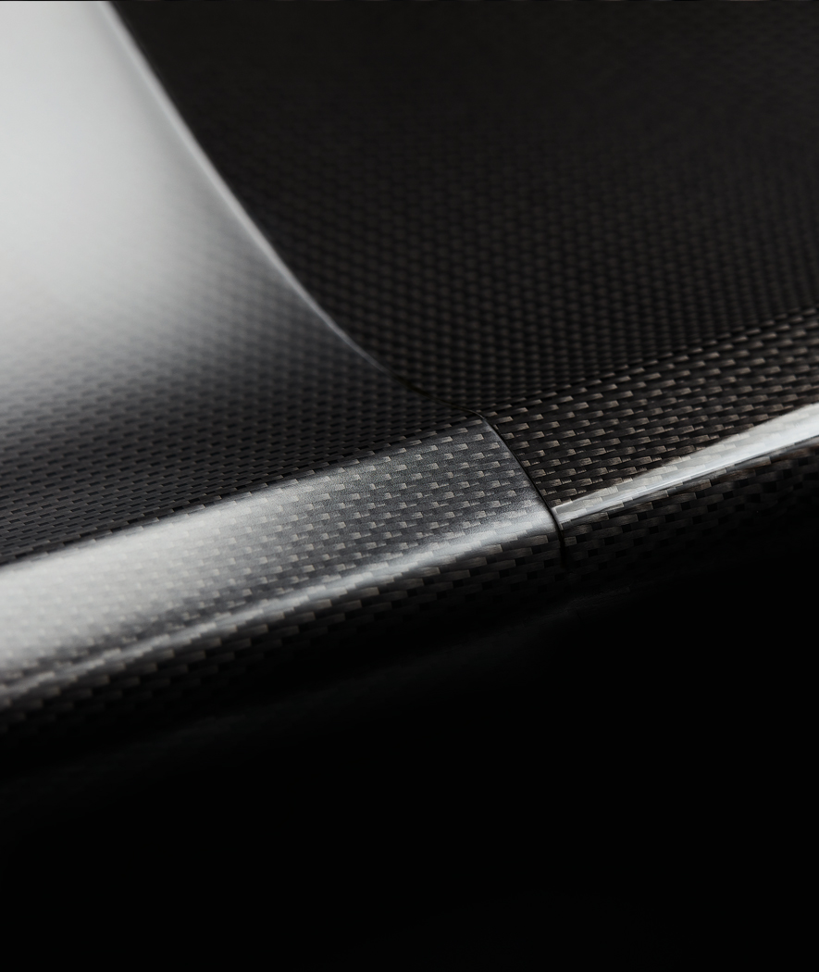
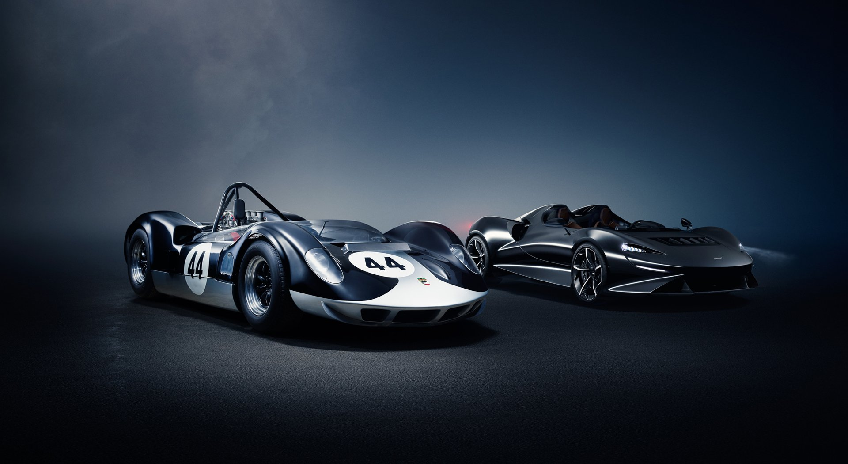
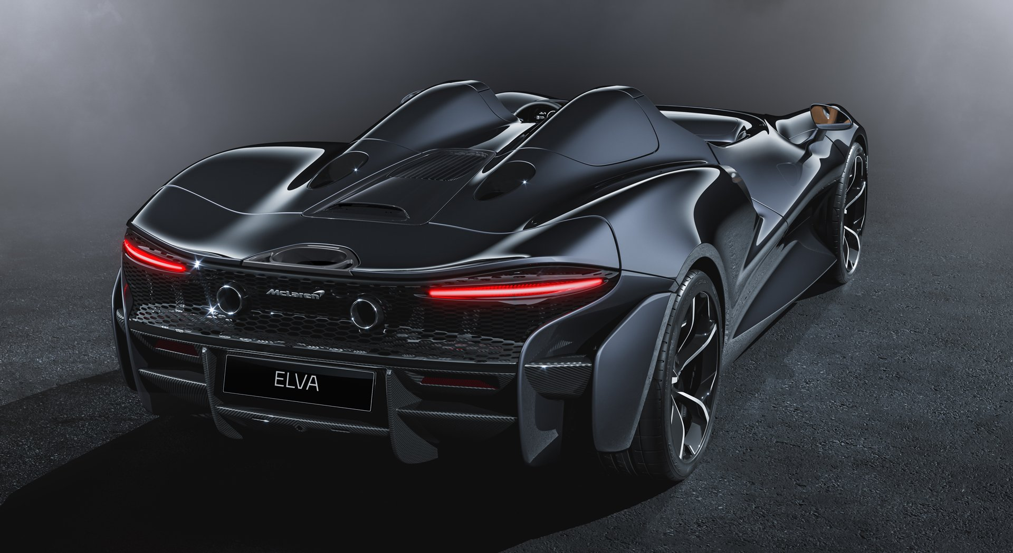

Slide 5
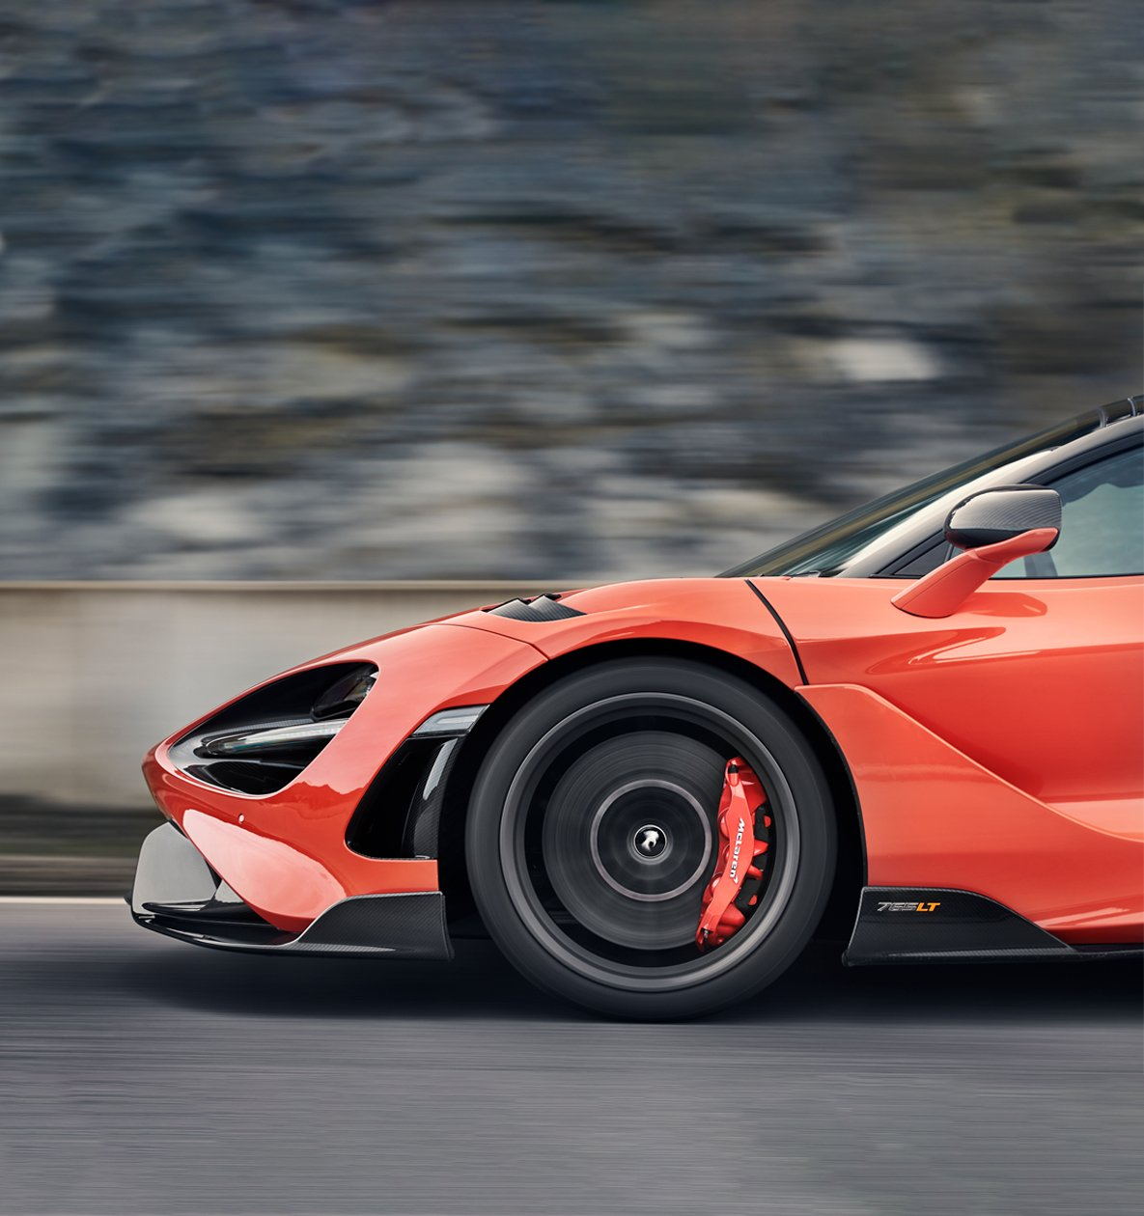
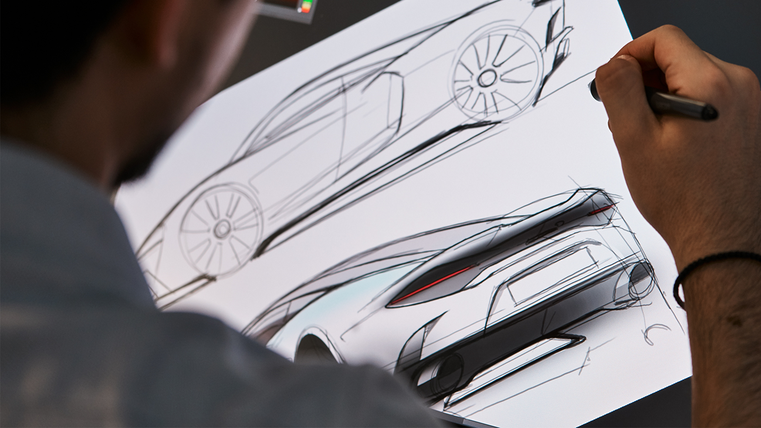
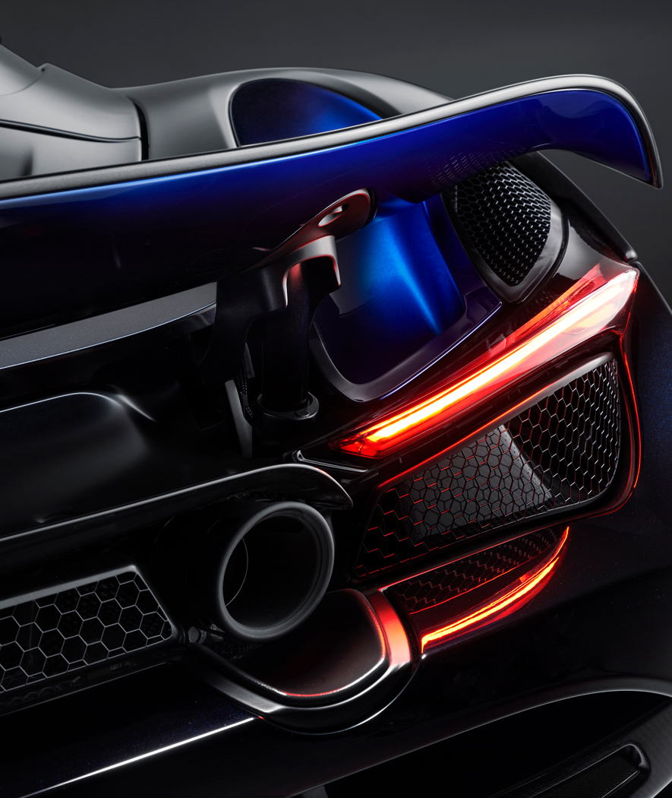

Slide 6
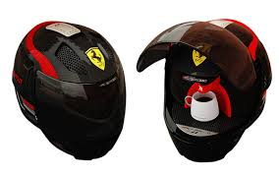
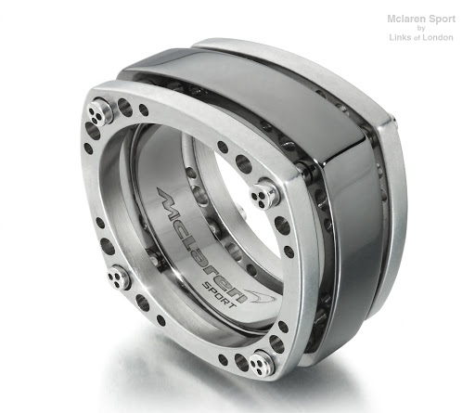
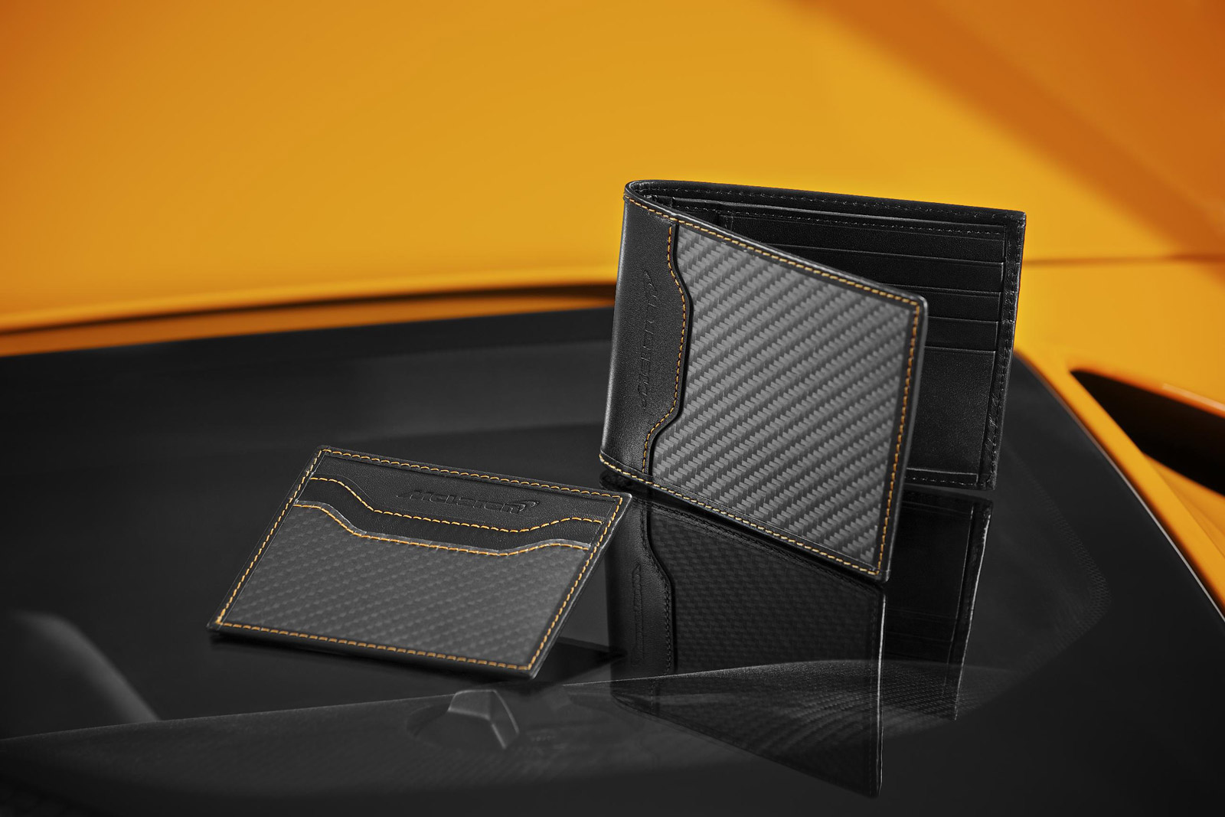
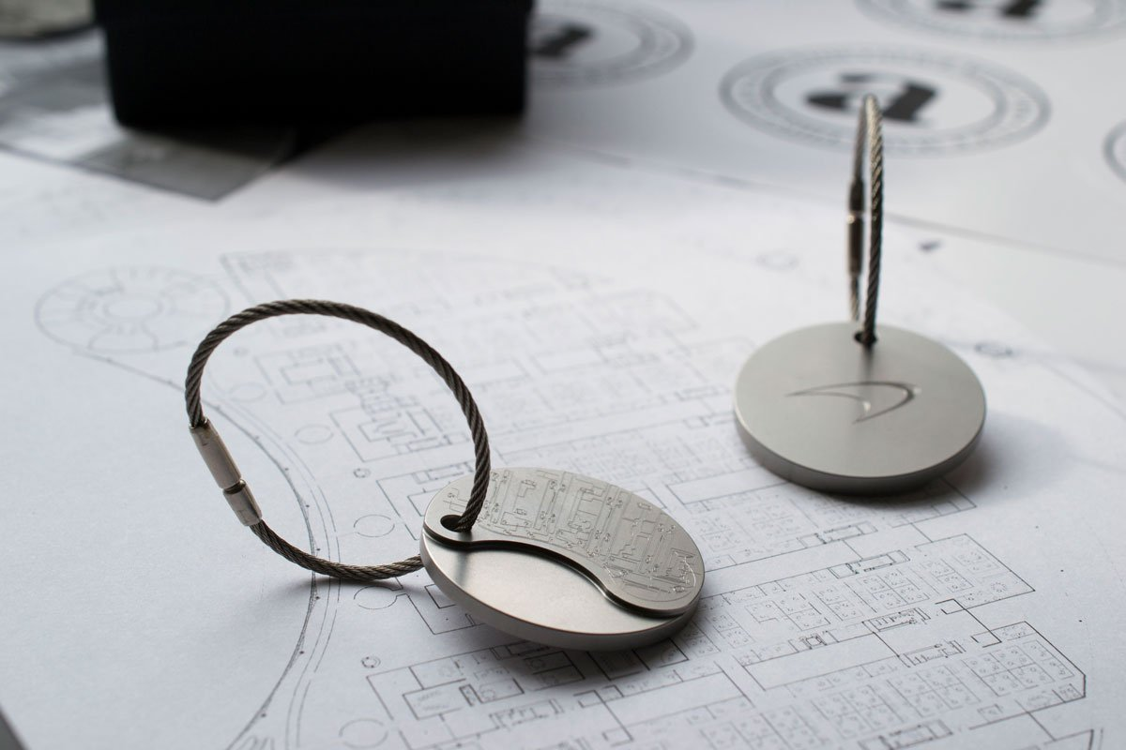
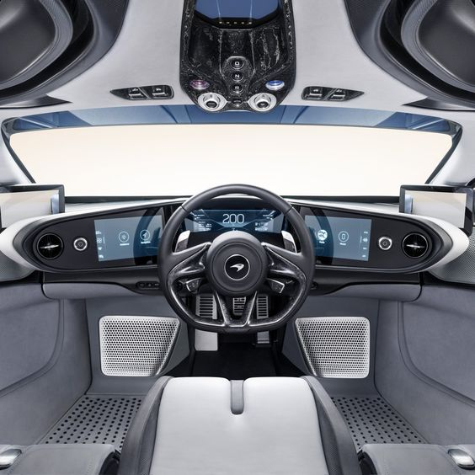
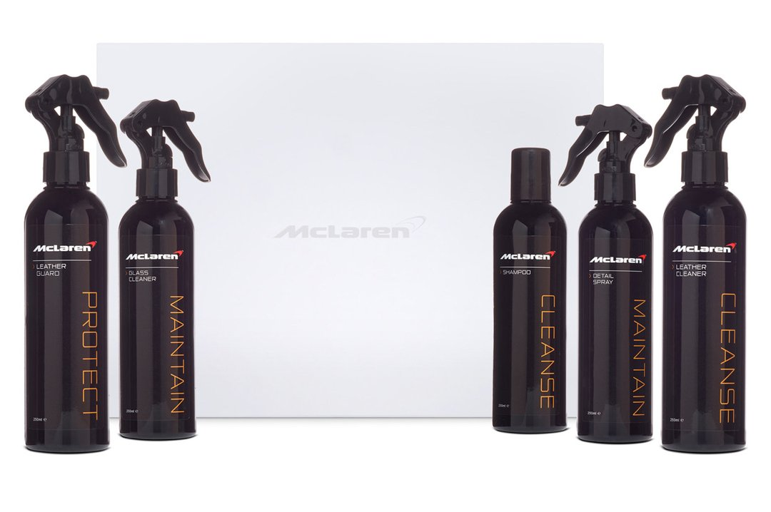
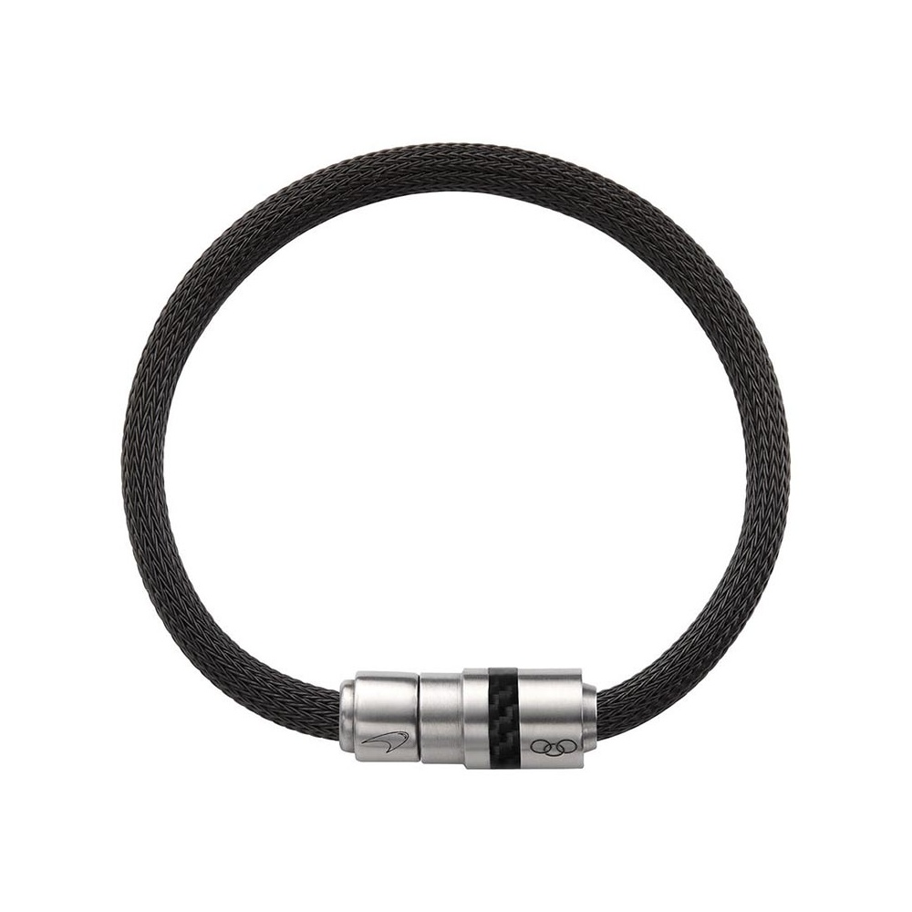
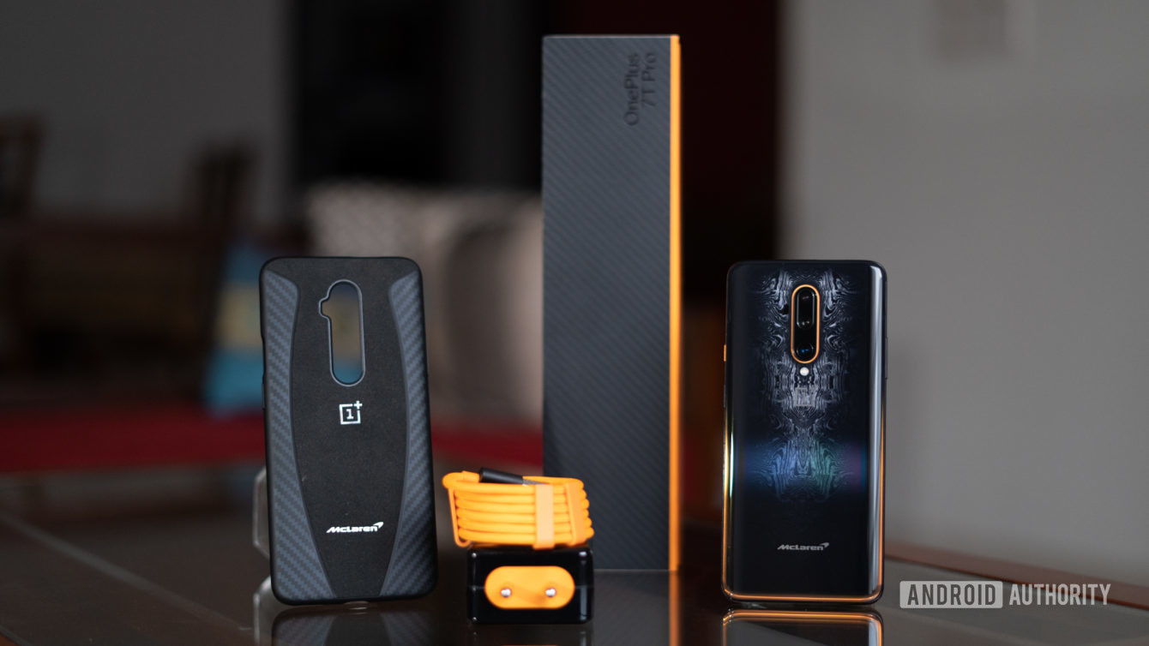
McLaren accessories

Slide 7
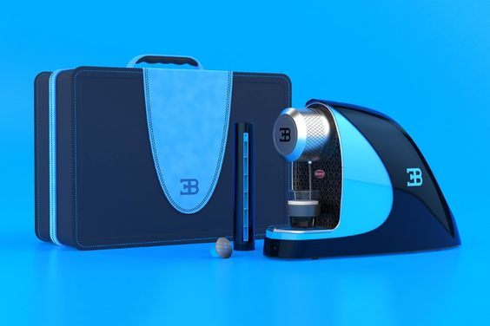
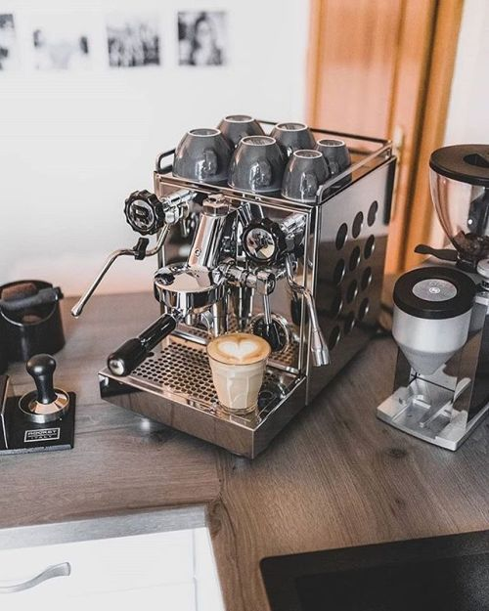
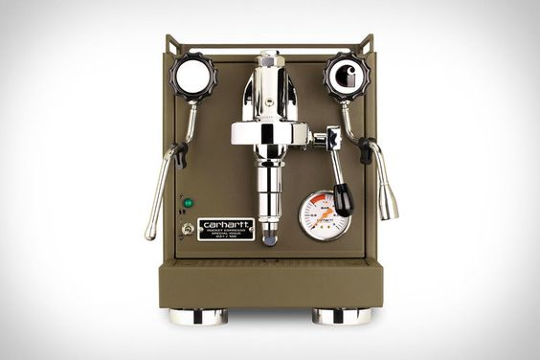
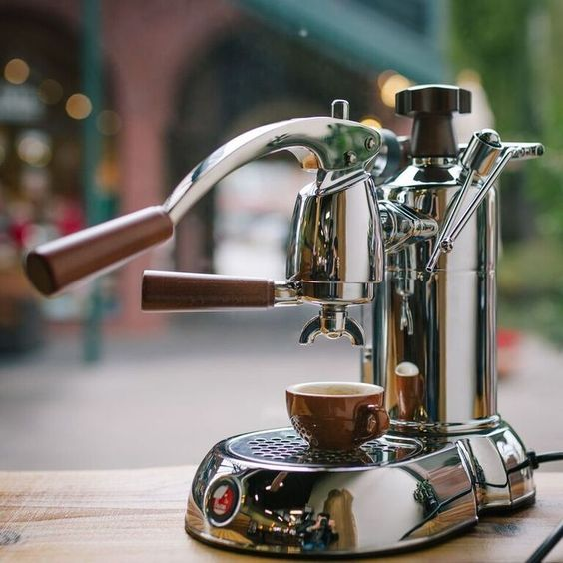
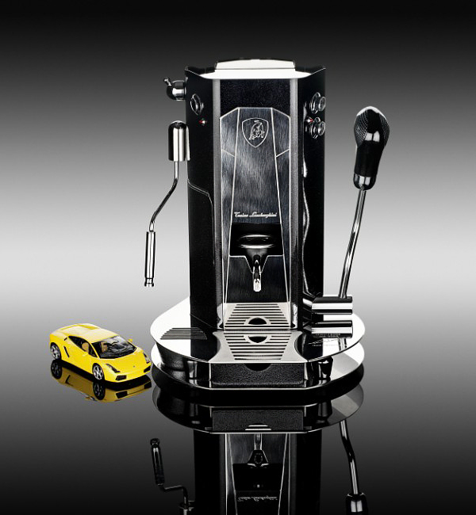
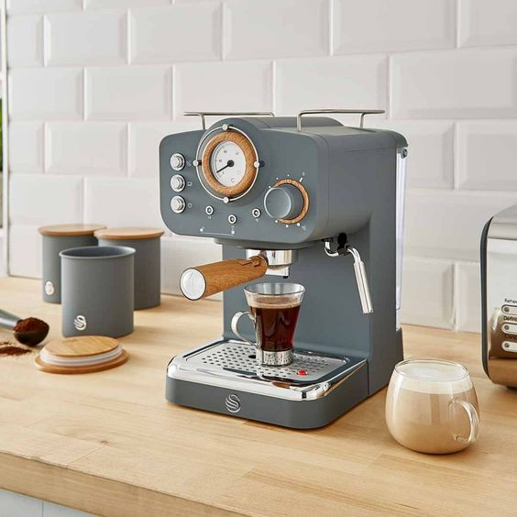
Espresso Machines

Slide 8
Picture links:
http://www.newcarcars.com/mt5808_ti5774/
https://www.pinterest.nz/pin/476326098074814487/
https://www.google.com/search?q=lamborghini+espresso+maker&rlz=1C1CHBF_enAU801CH833&sxsrf=ALeKk01S7l3lFZKobATaVlVgf-CO74FXWg:1595204955233&tbm=isch&source=iu&ictx=1&fir=9LsayvTXso2pKM%252CKpf4PI8rR3wb_M%252C_&vet=1&usg=AI4_-kQ8fkRT6-gguXG66dNh9gmxrJd8JQ&sa=X&ved=2ahUKEwjN_MzFydrqAhV9HDQIHaUtDnMQ9QEwBHoECAMQEw&biw=1500&bih=890&dpr=2#imgrc=Qi2q0DbM9kEpcM&imgdii=LlBlKxyV1xWB-M
https://www.google.com/search?q=mclaren+p1+dashboard&rlz=1C1CHBF_enAU801CH833&sxsrf=ALeKk03Bm_KU-qTVuG0wTsNUIbKzQLilAA:1595203125685&source=lnms&tbm=isch&sa=X&ved=2ahUKEwjwp5rdwtrqAhXHHjQIHRWcCOAQ_AUoAXoECA0QAw&biw=1500&bih=890&dpr=2#imgrc=A6S5cBBMepHRCM
https://www.google.com/search?q=mercedes+benz+coffee+roaster&rlz=1C1CHBF_enAU801CH833&sxsrf=ALeKk01BhAx7yDGqNTj2KBRkZTFc0EeXTQ:1595038319261&tbm=isch&source=iu&ictx=1&fir=QXNbSuSafsyBbM%252C0ccNs-1w9f3F-M%252C_&vet=1&usg=AI4_-kSkr1URpAhVAPSDzaDXlK858A8XAQ&sa=X&ved=2ahUKEwi5p7Dj3NXqAhW0FzQIHY6dDo8Q9QEwB3oECAkQEg&biw=1500&bih=890#imgrc=QXNbSuSafsyBbM
https://www.pinterest.nz/pin/129760033000539675/

